Slide 1
MACHINE LEARNING(25SC2107E)
MULTI-CLASS DISEASE DIAGNOSIS USING MULTINOMIAL LOGISTIC REGRESSION
Team Members
Name: M. Geethika Chowdary Rollno: 2520030056
Name: G. Varshini Rollno: 2520030017
Under the Esteemed Guidance of
Shaik Asif

Slide 2
Contents
Problem Statement & Objectives
Abstract
Existing System & Limitations
Exploratory Data Analysis (EDA)
Algorithms Used
Proposed Solution
Disease Prediction Workflow
Conclusion & Future Scope

Slide 3
Problem Statement & Objectives
Disease diagnosis requires analysis of multiple symptoms and patient characteristics.
Different diseases may have similar symptoms, making classification challenging.
Manual analysis of patient records can be time-consuming.
Machine learning can assist in predicting the most likely disease category.
Develop a multi-class disease prediction model.
Use symptoms and patient profile information as input features.
Apply Multinomial Logistic Regression for disease classification.
Evaluate the model using classification metrics.

Slide 4
Abstract
This project presents a machine learning-based approach for multi-class disease diagnosis using patient symptoms and profile information. The dataset contains features such as fever, cough, fatigue, difficulty breathing, age, gender, blood pressure, and cholesterol level. Multinomial Logistic Regression is used to classify patients into different disease categories. The proposed system processes the patient data, trains the classification model, and predicts the most likely disease. The project demonstrates how machine learning can be used as a decision-support approach for preliminary disease prediction.

Slide 5
Existing System & Limitations
Existing System
Traditional disease diagnosis generally involves:
Patient consultation with a healthcare professional
Collection of medical history
Analysis of symptoms
Physical examination
Laboratory and diagnostic tests
Limitations
Time-consuming for analyzing large numbers of patients
Manual dependency on medical expertise
Similar symptoms may occur in different diseases
Difficult to analyze large datasets manually
May not provide a quick preliminary prediction

Slide 6
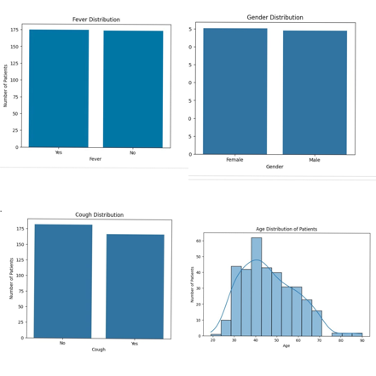
Exploratory Data Analysis (EDA)
EDA Steps :
Checked the structure of the dataset
Identified missing values and duplicates
Analyzed disease/class distribution
Studied patient age and gender distribution
Examined relationships between input features

Slide 7
Algorithms Used
Primary Algorithm:
Multinomial Logistic Regression
Purpose:
Multi-class disease classification
Input:
Patient symptoms and profile features
Output:
Predicted disease category
Why selected?
Suitable for multi-class classification
Simple and interpretable
Provides probability for each disease class
Flow:
Patient Features → Multinomial Logistic Regression → Disease Prediction

Slide 8
Proposed Solution
Our proposed system uses machine learning to predict the disease category from patient symptoms and profile information.
Process:
Patient Data Collection
Collect symptoms and patient profile information.
Data Preprocessing
Clean the data and convert categorical values into numerical form.
Feature Preparation
Prepare the selected input features for model training.
Model Training
Train the Multinomial Logistic Regression model using the prepared dataset.
Disease Prediction
Use the trained model to predict the most likely disease category

Slide 9
Disease Prediction & Workflow
Dataset
Disease Symptoms & Patient Profile Dataset
Data Preprocessing
Clean data + encode categorical features
Feature Preparation
Prepare the selected input features for model training
Train-Test Split
Divide data into training and testing sets
Model Training
Multinomial Logistic Regression
Prediction
Predict disease category
Evaluation
Accuracy, Precision, Recall & F1-Score

Slide 10
Conclusion & Future Scope
CONCLUSION
Developed a multi-class disease prediction system.
Used patient symptoms and profile information as input.
Applied Multinomial Logistic Regression.
Provides a data-driven approach for preliminary disease prediction.
Demonstrates ML application in healthcare.
FUTURE SCOPE
Add more symptoms and medical features.
Use larger and more diverse datasets.
Compare with other ML algorithms.
Develop a web/mobile prototype.
Explore advanced ML and deep learning techniques

Slide 11
Thank you

